Slide 1
20MCA182 Business Management
Module II

Slide 2
Syllabus
Planning: Nature and importance of planning, types of plans - Steps in planning, Levels of planning - The Planning Process - MBO definition and process, SWOT Analysis, importance.
Organising : Nature of organizing,-span of control in management, factors affecting span of control- Authority and responsibility.
Organisation structure - Formal and informal, Types of organization structure line, line and staff, functional, divisional, project, matrix, virtual form of organisations.

Slide 3
Introduction
First step of management process.
Definitions.
Planning as a process involves the determination of future course of action, ie why an action, what action, how to take action, and when to take action
Planning is defined as deciding in advance about the objectives to be pursued by the enterprise; the selection of best alternative courses or action to reach those objectives and a specification or activities - technical, financial, personnel etc. required for the implementation or the pre-selected courses or action.
Planning is process which involves ‘thinking before doing’.

Slide 4
Continues..
Major components of planning:-
Initial Planning(Basic Planning) :- determination of objectives.
Subsequent Planning(Route Planning) :- selection of best alternative courses of action.
Final Planning(Operational Planning) :-
What technology is required?
How much finance is required ?
Who is responsible for the implementation of the plan?
Etc..

Slide 5
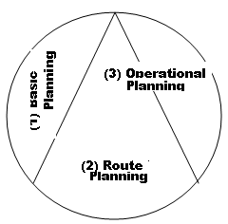
Continues..

Slide 6
Features of planning
Planning is a process rather than behaviour at a given time. This process determines the future course of action.
Planning is primarily concerned with looking into future. It requires forecasting of future situations.
Planning involves selection of suitable course of action.
Planning is undertaken at all levels of organisation.
Planning is flexible.
Planning is pervasive(present everywhere) and continues managerial function involving complex processes of perception, analysis, conceptual thought, communication, decision, and action.

Slide 7
Nature of Planning
3 basic natures of planning are
Rational approach.
An open system approach.
Pervasiveness of planning.

Slide 8
Rational approach
Defines where one stands, where one wants to go in future and how to reach there.
Rationality denotes the choice of appropriate means of achieving stated objectives.
Filling the gap between actual status and desired status.

Slide 9
An Open system approach
Planning adopts an open system approach.
Planning takes input from environment, process these, and exports outputs to environment.
Planning is influenced by a verity of environmental factors like economic, political-legal, technological, socio-cultural, and competitive.
Planning should consider the dynamic features of the environment.

Slide 10
Pervasiveness of planning
Planning is pervasive and extends throughout the organisation.
Every manager in the organisation has to plan.
Top level planning.
Middle level planning.
Low level planning.
Example
Corporate or organisational plan
Divisional plan
Departmental plan
Sectional plan

Slide 11
Nature of Planning
Constitutional features
1) Planning is goal-oriented.
2) Planning has a reference to future.
3) Planning is the primary function of management.
4) Planning involves choice.
5) Planning is an intellectual (or mental) exercise.
Operational features
6) Planning is all-pervasive.
7) Planning is both - long range and short range.
8) Planning is continuous. Desirable features.
Desirable Features
9) Planning is actionable.
10) Planning is flexible.
11) Planning is an integrated system.
12) Planning is efficient.

Slide 12
Importance of planning
Primacy of planning.
To offset uncertainty and change.
To focus attention on objectives.
To help in coordination.
To help in controlling.
To increase organisational effectiveness.

Slide 13
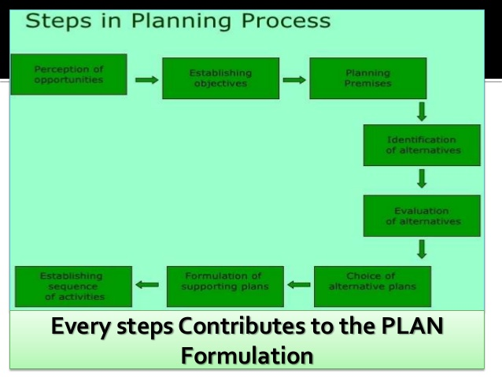
Steps in planning

Slide 14
Another dimension

Slide 15
Steps in planning
Perception of objectives(not a planning process-just awareness).
Establishing objectives.
Planning premises.
Identification of alternatives.
Evaluation of alternatives.
Choice of alternative.
Formulation of supporting plans
Establishing sequence of activities.

Slide 16
Types of planning or Levels of planning
Planning may be differentiated on the basis :-
Coverage of the organisational activities.
Importance of contents in the planning process.
Time dimension in planning.
Approach adopted in planning.
Degree of formulation in planning process.

Slide 17
Types of planning
 | Demensions | Types of planning
1 | Coverage of activities | Corporate and functional planning
2 | Importance of contents | Strategic and tactical/operational planning
3 | Time period involved | Long-term and short-term planning
4 | Approach adopted | Proactive and reactive planning
5 | Degree of formulization | Formal and informal planning

Slide 18
Corporate and Functional planning
Planning activity is pervasive and can be undertaken in many levels of an organisation.
It may be for the total organisation or for functions in the organisation.
Corporate planning
Top level planning.
Covers the entire organisation.
Determine the long term objectives.
Finding the probable change that may happen.
Functional planning
It is segmental.
Planning undertaken for major functions like production, marketing, finance, HR, etc.
The second level, functional planning is undertaken sub function within the functions like for marketing – sales, sales promotion, marketing research etc.

Slide 19
Strategic and Operational Planning
Planning may be divided into strategic and operational planning depending on the direction of actions set of organisation.
Strategic Planning
Sets the long-term direction of organisation in which it wants to proceed in future.
It sets future direction of the organisation.
Are generally developed by top level management.
It involves a time horizon of more than one year and for most of the organization it ranges between 3 and 5 years.
Example :- Diversification of business into new lines, type of products to be offered, long-term profit etc.

Slide 20
Strategic and Operational Planning
Operational Planning
Tactical or short-term planning
Operational plans are developed to determine the steps necessary for achieving tactical goals..
They are used as a guide for day to day operation by department managers.
These plans may cover a time frame of few months, weeks or even a few days.
Example :- production of a financial year, budgeting, production for a day etc.

Slide 21
Difference between strategic and operational planning.
Range of choice.
Type of environment.
Primacy.
Level of formulation.

Slide 22
Long-term and short-term planning
Time period.
Depends on the type of the buisness and structure of the organisation.
Long-term planning
Strategic in nature.
Involves generally 3-5 years.
It relates to matters like new product ,product diversification, individuals in the organisation, etc.
Short-term planning
Short term planning typically covers time frames of less than one year in order to assist their company in moving gradually toward its longer term.
Involves less than one year time.

Slide 23
Proactive and reactive Planning
Is based on the organisation’s response to the environmental dynamics.
Proactive Planning
Designing suitable course of action in anticipation of likely changes in relevant environment.
To take decision in advance.
Eg : Emergency situations.
Reactive Planning
Reactive planning is the process whereby future action is dictated as a response to whatever has already, or is now occurring.
Eg. Hotel Manager.

Slide 24
Formal and Informal Planning
FORMAL PLANNING
It is a structured plan.
It has some procedure to follow.
Written record is followed in formal plan.
Eg. Five year plan of a country.
INFORMAL PLANNING
It is unstructured plan.
It does not have any procedure to follow.
No record is maintained for future purpose.

Slide 25
Structure of planning or Types of Plans
Basic Planning
1)Mission
2) Objectives (or goals)
3) Strategies
Aids to Planning
4) Policies
5) Rules
6) Procedures
7) Methods
Expression to Planning (or Plans of Action)
8) Programs
9) Projects
10) Budgets

Slide 26
Advantages (or significance) of planning
Planning helps management to face future with greater strength and confidence.
It helps to focus attention on objectives.
It leads the operational life of the enterprise along the most efficient lines.
It enables the exercise of controlling.
It acts as a spur to creativity and innovation.
It guides the decision-making process.
It provides a sense of direction to action.
It facilitates co-ordination.
It fosters inter-departmental co-operation.

Slide 27
Limitations of planning
Limitations of forecasting.
Egoistic planning.
Organizational inflexibilities.
Wastage of resources.
Imparting a false sense of satisfaction.
External constraints.
Unreliable and inadequate background information.
Unsuitability in emergency situations.

Slide 28
Characteristics of a sound plan.
Simple to understand and operate.
Based on rational forecasts.
Consistent with the environment.
Realistic and non idealistic.
Flexible.
Efficient (or economical).
Imply best utilization of the resources of the enterprise.
Must provide scope for initiative.
Must win employees favor and confidence.
Must contribute to fundamental mission of the enterprises.

Slide 29
MBO – Management by Objectives
Or MBR – Management by results.
MBO is because of 2 reasons:-
Focus on the objectives or results which a manager is expected to achieve in a specified period.
It emphasises participative management, which provides high motivation.
Definition
MBO is a result centered, non-specialist, operational managerial process for the effective utilisation of material, physical and human resources of the organisation by integrating individual with the organisation and organisation with the environment.
MBO is a distinct philosophy of managing any business enterprise in which(under short-term management programme) objectives for the subordinates are workedout through a process of mutal consultation between subordinates and concerned superiors, in verifiable(numerical terms); and such objectives subsequently becoming standards of control for measuring performance of individuals against these.

Slide 30
Process of MBO
Preliminary setting of objectives at the top management level.
Clarification of organisational roles.
Setting individual objectives.
Matching goals with resources.
Recycling objectives.
Performance appraisal.

Slide 31
Merits and limitations of MBO
Merits
Overall improvement in organizational performance
Specific Planning
Elicits commitment
Better controlling
Limitations
Failure of teach philosophy of MBO.
Tug-of-war phenomenon.
Over-emphasis on short-run goals.
Over-quantification of management.
Wastage of time.

Slide 32
SWOT
Also called TOWS.

Slide 33
Purpose of SWOT
To take best advantage on the strengths of the company.
To overcome the weaknesses of the company.
To exploit fully the opportunities of the external environment.
To manage successfully the threats posed by the external environment.

Slide 34
Environment Analysis.
2 environments
Internal environment
All that environment which is found within the business enterprise itself, may be termed as the internal environment of business.
External environment
All that environment which obtains and prevails outside the business enterprise may be termed as the external environment.

Slide 35
Internal Environment
Internal environment can be divided into following factors:-
Philosophical Environment
Mission, values, beliefs, long term goals, organisational culture etc.
Managerial Environment
Management hierarchy, quality of managerial talents, process of managerial development etc.
Structural Environment
Rules, polices and procedures of the organisation.
Authority-responsibility relationship.
Communication networks.
Controlling techniques.

Slide 36
Continues..
Production Environment
Raw material availability and utilisation system.
Technology available.
Plant capacity utilisation.
Quality control system etc.
Marketing Environment
Marketing research system and procedures.
Training and compensation of sales.
Advertising and other sales promotion techniques etc.
Personal Environment
Quantity and quality of manpower.
Systems of training , promotions and compensation of workmen.
Type and nature of manpower planning etc.

Slide 37
Continues..
Financial Environment
Working capital management.
Capital budgeting – techniques and procedures.
Financial discipline enforced in organisation
Human Relation Environment
Line-staff harmony and conflicts.
Management labour relation.
Relation between workers.
Public relations.

Slide 38
External Environment
Salient features of external environment:-
External environment is unlimited.
External environment is beyond the control of management.
External environment is very complex; and various factors comprised in it may be highly interrelated and interdependent.
External environment is highly volatile and turbulent.
External environment is subject to perception values.

Slide 39
Continues..
Major factors comprised in external factors:-
Political factors
Whether united front or single party government.
Political stability.
Taxation attitude towards business.
Polices of liberalization.
Import-export orientation etc.
Legal factors
Commercial laws.
Industrial laws.
Import-export regulations etc.
Social-religious-cultural factors.
Population growth and trends.
Level of education in society.
Craze for a standard of living etc.

Slide 40
Continues..
Competitive factors.
Technological factors.
General economic factors.
A craze for low priced products.
Tendency to save, spend, etc.
Financial factors.
Polices of banks and financial institutions.
Stock market environment.
Structure of interest rates etc.
Natural Environment factors.
Natural resources.
Climate.
Geographical features.

Slide 41
Organising
The second function of management is organising.
After planning the issues before managers are:
What is to done?
Who will do it?
What will be relationship among employees?
These aspects are performed by a function of management called organising.
Organising involves :
Analysis of the activities to be performed for achieving organisational objectives.
Grouping of these activities into various divisions, departments, and sections.
So that these activities can be assigned to various individuals and delegating them appropriate authority – they can carried out the work effectively.
Organising and organisation are same.

Slide 42
Continues..
Organizing is that managerial process which seeks to define the role of each individual(manager and operator) towards the attainment of enterprise objectives; with due regard to establishing authority responsibility relationships among all; and providing for co-ordination in the enterprise-as an in-built device for obtaining harmonious group action.

Slide 43
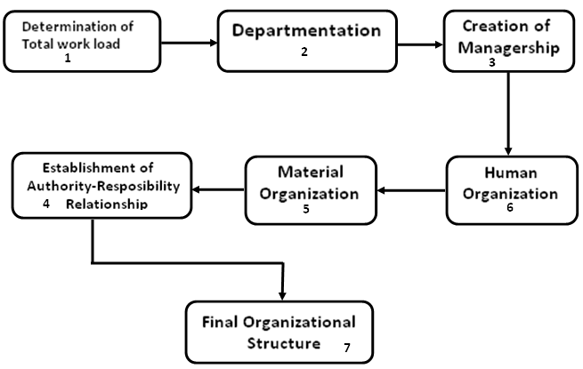
Process of Organising

Slide 44
Continues..
Determination of the total work-load.
Grouping and sub-grouping of activities ie. Creation departmentation.
Creation of managership through delegation of authority.
Human organisation – Division of work within the departmental set-up.
Material Organisation – Arrangement of physical facilities to personnel within the departmental set-up.
Definition and establishment of authority-responsibility relationships.
Final organisational structure.

Slide 45
Concept of organising
Terms related to organisations are:-
Entity.
Enterprise as a whole.
Eg: company, corporation, etc.
Group of people.
Related to different groups formal and informal.
So the organisation has following features:-
An organisation always refers to people.
The organisation is composed of people who interact among themselves.
The interactions are specified by some sort of structure ie who will interact with whom.
The interactions are meant to achieve some sort of objectives.

Slide 46
Continues..
Structure.
An organisation should have a structure which prescribes the relationship among individuals and positions they hold.
Process.
Process has following elements.
Departmentation.
Linking departments.
Defining authority and responsibility.
Prescribing authority relationships.

Slide 47
Principles of Organisation
Overall Principles
(i) Principle of unity of objective.
(ii) Principle of simplicity.
(iii) Principle of flexibility.
Structural Principles
(i) Principle of division of work.
(ii) Principle of functional definition.
(iii) Principle of optimum departmentation.
(iv) Principle of unity of direction.
(v) Span of management principle.
Operational Principles
(i) Principle of adequate delegation.
(ii) Scalar chain principle.
(iii) Authority-level principle.

Slide 48
Departmentation
In designing an organisation structure first identify the activities in the organisation and group them properly. This grouping of activities are called departmentation.
In business organisation departments are also called division, department, section etc.
In government departments are also called branch, department, bureau, section etc.
In military departments are also called battalion, group, company etc.

Slide 49
Need and Importance of Departmentation
Advantage of specialisation.
Fixation of responsibility.
Development of managers.
Facility of appraisal.
Feeling of autonomy.

Slide 50
Bases of Departmentation
Grouping of common or homogeneous activities to form an organisational unit is called functional departmentation.
Departmentation is implemented on the basis of some criteria:-
Function
Basic function.
Secondary function.

Slide 51
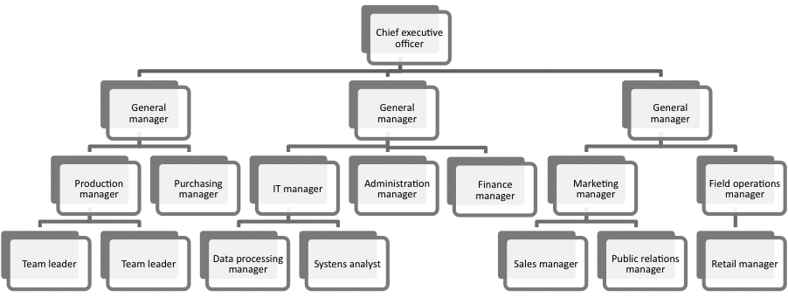
Continues..

Slide 52
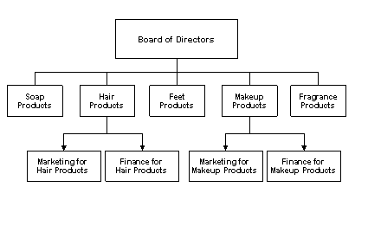
Product Based

Slide 53
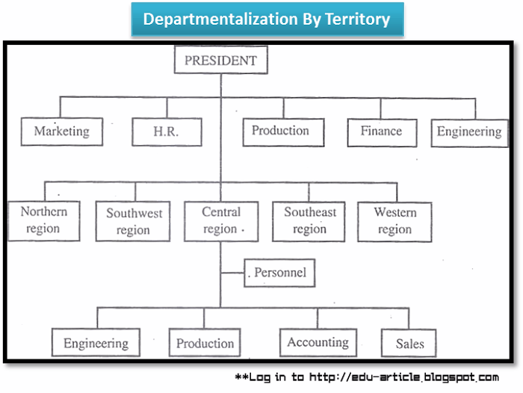
Territory Based Departmentation

Slide 54
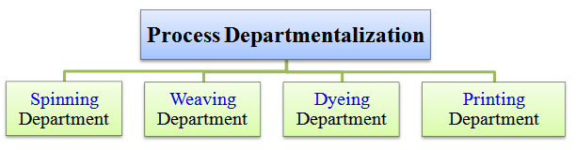
Process Based Departmentation

Slide 55
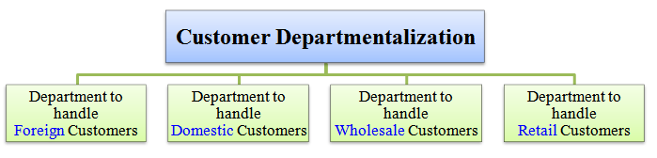
Customer Based Departmentation

Slide 56
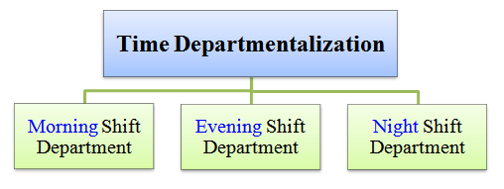
Time Based Departmentation

Slide 57
Alphanumerical Based Departmentation
Alphanumerical.
Departments are created on the basis of persons or an alphabets.
A certain number of persons are kept under the supervision of one person irrespective of the fact that what they do, where they do and how they do.
This method is used in lower levels of hierarchy, military organisations etc.

Slide 58
Choice of bases for departmentation
A suitable basis of departmentation is one which facilitates the performance of the organisational functions effectively and efficiently.
According to the type of organisation the basis may change or the combination of various basis are adopted.
Considering some factor depatmentation may be done:-
Specialization.
Coordination.
Control.
Economy.
Focus on results.
Local conditions.
Human consideration.

Slide 59
Span of management
Departmentation creates a problem: how many individuals should be placed under a supervisor.
Span of management or span of control or span of supervision.
A supervisor or superior is responsible for the total activities of his subordinates.
Span of management refers to the number of subordinates who can be managed effectively by a superior.

Slide 60
Continues..
The number of subordinates who report to a superior has two important implications.
It is influential in determining the complexity of individual manager’s job.
The span of management determines the shape or configuration of the organisation.
The fewer the number of people reporting to the superior, the larger the number of managers required.
Ie. The number of subordinates reporting to a superior should be fixed.

Slide 61
Determination of span of management
There are three types of superior-subordinate relationships:-
Direct single relationships.
Direct group relationships.
Cross relationships.

Slide 62
Factors affecting span of management
Capacity of the superior.
Capacity of the subordinates.
Nature of work.
Degree of decentralisation.
Degree of planning.
Communication techniques.
Use of staff assistance.
Supervision from others.

Slide 63
Continues..
Wide or narrow span.
Tall structure.
Flat structure.

Slide 64
Formal and Informal organisations
Definition of Formal organisation
It is a deliberately designed structure of roles; which is built by management through assigning a matching role to each one of the group for facilitating individuals-to best attain the objectives of the enterprise.
Definition of Informal organisation
An informal organization is a social group of individuals which comes into existence automatically - as a result of the operation and Interaction of certain socio-psychological factors, among persons who are working In various capacities within the four walls of the formal organization.

Slide 65
FACTORS RESPONSIBLE FOR THE EMERGENCE OF INFORMAL ORGANISATIONS
Desire to socialize with others.
Necessity for exchanging information.
To release boredom caused by modern specialization.
Need for collective action against the high-handedness of Management.
Inborn leadership.
Mutual protection under emergency situations.
Consultation on work-matter.
Common link or affiliation among a group of persons.

Slide 66
Advantages of Informal organisation
From the view point of management
More productivity and production.
Communication feedback.
Innovation and creativity encouraged.
A more humanistic formal organization.
From the view point of members.
Bulwark against management.
Management made Alert and responsible.
Solutions to work-problems.
Doing away with emotional tensions.
A system of self-help in emergency situations.

Slide 67
Limitations of Informal organisation.
From the viewpoint of management
Spread of rumors.
Resistance to change.
Less than optimum production.
Reduces predictability of human behavior.
Problems of indiscipline.
From the viewpoint of the members
Role-conflict.
Political domination of informal groups.
Loss of self-entity.

Slide 68
Comparison of formal and informal organisations.
NO: | FORMAL | INFORMAL
1. ORIGIN | DELIBARATE CREATION | SELF-GENERATING PROCESS
2 . OBJECTIVES | SPECIFIC OBJECTIVES | NO SPECIFIC OBJECTIVES
3. FUNCTIONING | ACCURATE AND PREPLANNED RULES,POLICIES & PROCEDURES | NO RULES
4 . AUTHORITY –RESPONSIBILITY RELATIONSHIP | CLEAR-CUT | NOT CLEAR-CUT
5 . WORK ROLE | DELIBRATELY ASSAIGNED WORK ROLE | PERSONAL ROLE OF CASUAL NATURE
6. BEHAVIOUR MOULDING | SYSTEM OF REWARDS & PUNISHMENTS | SHAPED BY CONVENTIONS ,VALUES & BELIEFS
7. LEADERSHIP | BY VIRTUE OF OFFICIAL STATUS & AUTHORITY | PERSONEL POER & PERSONALITY
8. COMMUNICATION SYSTEM | PLANNED THROUGH SCALAR CHAIN, AUTHENTIC & RELIABLE | LEAST AUTHENTIC & RELIABLE
9. STABILITY | MOST STABLE | LEAST STABLE
10. SIZE OF ORGANISATION | MODERATE OR LARGE SIZE | EXCEPT LABOUR ORGZ’N, SMALL SIZE
11. POLITICAL DOMINATION | NO POLITICAL DOMINATION | POLITICALLY DOMINATED
12. MEMBERSHIP & STATUS | MEMBER OF ONLY ONE FORMAL GP WITHIN THE OFFICIAL STATUS | VARIOUS INFORMAL GROUPS- BIG OR SMALL

Slide 69
Types of organisations
On the basis of authority-responsibility relationships, organizations might, broadly be one of the following basic types:
(I) Line organisation
(II) Functional organisation
(III) Line and staff organisation

Slide 70
Line organisation
Is defined as an organisation with line of authority responsibility is found.
Features of line organisation.
The scalar chain principle.
Unity in command.
Span of management: number of subordinates are kept limited according to the competence of the manager.
Two types of line organisations:
Pure line organisation.
Departmental line organisation.

Slide 71
Pure Line Organisation
Chief executive/
General manager
Dept. 1 Manager
Dept. 2 Manager
Dept. 3 Manager
Asst. Manager 1
Asst. Manager 2
Subordinates

Slide 72
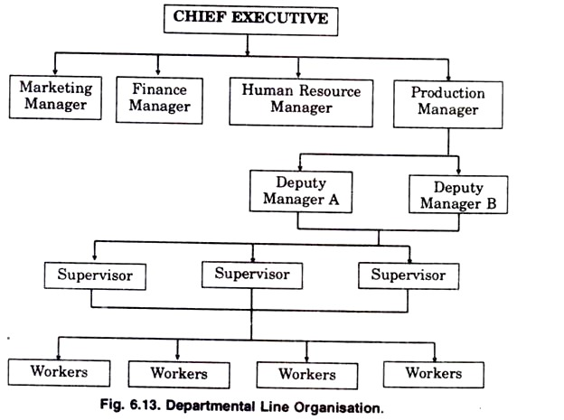
Departmental Line Organisation

Slide 73
Merits of line organisation
Simple.
Quick-decision-making.
Fixation of responsibility.
Smooth flow of work.
Two-way communication.
Effective management.
Executive development.

Slide 74
Limitations of line organisation.
Over-loading on managers.
Lack of specialization.
Dictatorial management approach.
Delayed communication.
Unsuitable under present-day-environment.

Slide 75
Functional Organisation
In functional organizations is all business functions are divided among various activities or functions; and each of the function is entrusted to a specialist.
The highlight of this type of organisation is the exercise of functional authority by a functional manager or specialist over all the subordinates in all department.
So his specialization is performed by all the subordinates.

Slide 76
Continues..
Features of Functional Organisation:
(i) A functional organisation is based on the following principles:
The principle of 'total departmentation',
The principle of 'precise departmentation' or clear-cut departmentation,
The principle of 'related departmentation',
(ii) The functional organisation makes extensive use of managerial specialisation; as each business function is entrusted to a distinct specialist.
iii) A functional organisation is regulated by the 'multiple-command-system ' which is absolute violation of the unity of command, where each subordinate in the organisation is subject to multiple orders by different functional specialists each one regarding their own functional area.

Slide 77
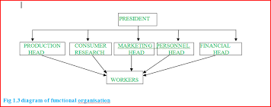
Chart of functional organisation

Slide 78
Merits and Limitations of Functional organisation
Merits
Relief from over-burdening.
Healthy competition among experts.
Dictatorial approach avoided.
Suitable in the present-day-times.
Limitations
Drawbacks arising from multiple command system.
Higher costs of administration.
Narrow outlook of specialists.
Overall managerial development retarded.

Slide 79
Line and Staff Organisation
It is a combination of line organisation and functional organisation.
Practical type organisational structure.
Line and staff type of organization is one structure, designed by organizational experts; which seeks to combine the positive side of both-line and functional organizations, in a unique manner.
Definition
Line and staff organization is one, in which there is basic departmentatlon for primary business functions, operated on the concept of the scalar chain, with provision for specialized activities performed through staff officers, the managers acting in advisory capacity.

Slide 80
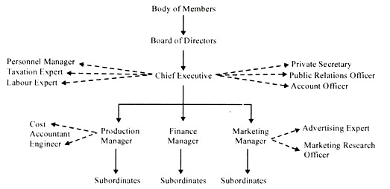
Chart of line and staff organisation

Slide 81
Line and staff organisation
Features of line and staff organisation.
Principle of Scalar chain.
Principle of specialisation.
Merits
Advantages due to line of command.
Advantages due to managerial specialization.
Undisturbed line of command due to advisory role of the staff.
Sharing of organisational burden.
Growth of enterprise facilitated.
Limitations
Problem of conflict.
Higher organisational costs.
Problems of co-ordination.
Limited, functional authority-a source of displeasure and misuse.
Over-dependence on staff services.

Slide 82
Divisional Organisations
Also called profit decentralisation.
Organisation is divided into several autonomous units.
Each unit is relatively self-contained in that it has the resources to operate independently of other divisions.
Each unit is headed by a manager who is responsible for the organisation’s investment in facilities, capital, and people as well as for unit’s development and performance.
Divisional structure is similar to dividing an organisation into several smaller organisations.
Each division is not independent.
Each unit is not a separate legal entity.
Each unit is part of organisation.
Each unit is directly accountable to the organisation.

Slide 83
Divisionalisation
There are two traditional bases of divisionalisation.
Product
Territory
New bases of divisionalisation is strategic business units.
Strategic business units.

Slide 84
SBU
Strategic Business Unit.
In multiproduct or multi-geographical area companies, divisions are created in the form of SBUs.
Identify the independent product/market with distinct environment.
SBUs is created for each such segments.
In creating SBU’s, following features are important:-
Each SBU is managed as a portfolio of the organisation with a clearly defined product/market segment and clearly defined strategy.
Each SBU develop its strategy tailored to its needs with aligning it to corporate capabilities and needs.
Each SBU is allocated resources – both human and physical – according to its needs and contributions to the achievement of organisational objectives.

Slide 85
Design of Divisional Organisation Structure
Issues that affect divisionalisation are:-
Number of divisions.
Provisions of corporate staff activities.
Relationship between corporate and divisional management.

Slide 86
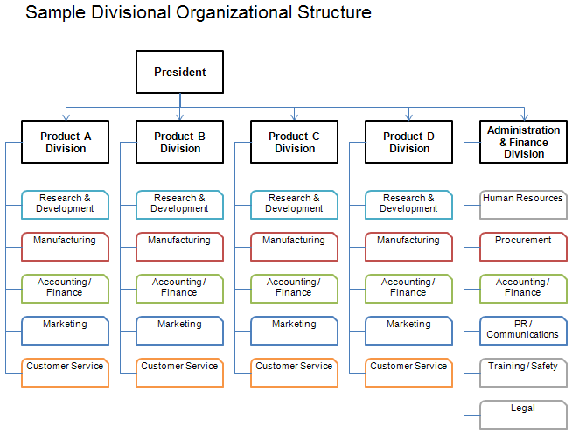
Chart of Divisional organisation.

Slide 87
Advantages of divisional structure
Gives more emphasis on the end result.
Focuses on particular product or service, performance measurement much more easier.
There is higher level of managerial motivation because managers work in the environment of autonomy.
More managers with general outlook can be developed who can easily take up the job at the corporate level.
Organisational size can be increased without any problem as new divisions can be opened without disturbing the existing system.
Each product or customer is able to get specialised service because the attention is focused by a division exclusively for it.

Slide 88
Disadvantages in divisional structure.
It is costly because all the facilities have to be arranged for each divisions.
Since there is a lack of emphasis of functional specialization, many professionals do not feel satisfied with this structure.
There is a lack of managerial personal when a new division is opened because managers working within a division cannot work with same efficiency in other division as they must have acquired the technical competence of that division.
Control system is a major problem of divisionalisation. Though each unit is measured in terms of its contributions to the organisation, this system will not work properly.

Slide 89
Project Organisation
A project organisation is one, in which a project structure is created as a separate unit or division within a permanent functional structure; drawing specialists and workers from various functional department who work under the overall leadership, control and co-ordination of a project manger-to complete projects of a technical and costly nature.

Slide 90
Continues..
Why a project organisation is needed?
Project of a technical nature.
Project completion requires huge cost.
Time factor is critical.
Advantages of project organisation.
Concentrated attention on project work.
Advantages of team specialization.
Ability to cope with environmental influences.
Timely completion of the project.
Limitations
Increased problems of co-ordination.
Unclearly defined relationships.
Feeling of insecurity among personnel.
Duplication of efforts.

Slide 91
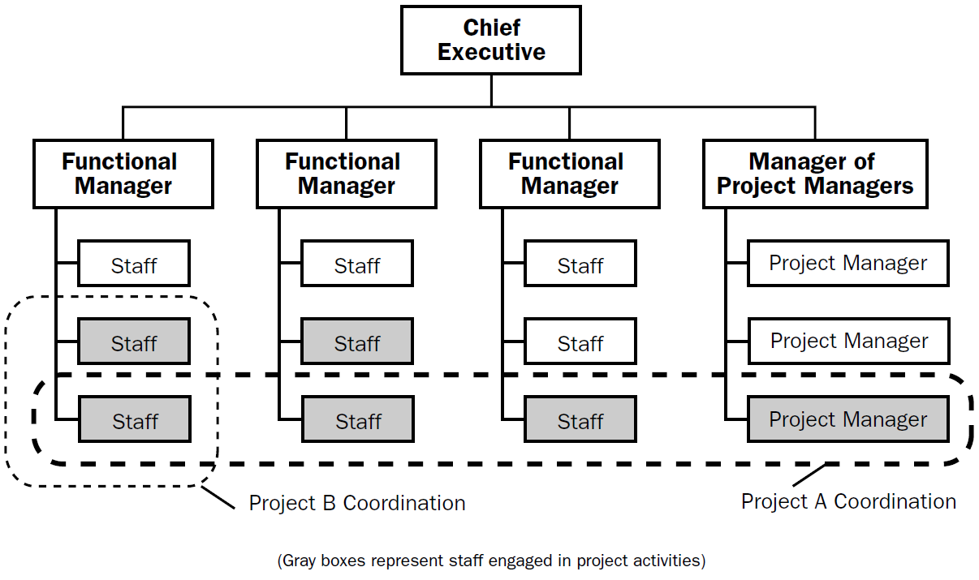
Continues..

Slide 92
Matrix Organisation
When an enterprise undertakes a large number of small projects, a matrix organisation is more suitable.
It is a combination of functional departmental organisation and project organisation.
A matrix organisation is characterized by two major features:
It undertakes large number of small projects.
There is dual line of command, in a matrix organization.
Definition
Matrix organisation is similar to project organisation, matrix organisation has a permanent functional structure of the organisation; and the members if the project team being subject to dual line of command(project manager and manager of the function that he belongs to) – forming a matrix grid. Hence it is called matrix organisation.

Slide 93
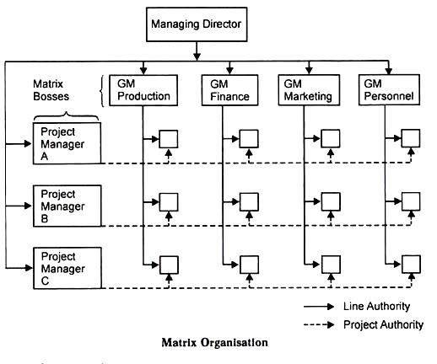
Continues..

Slide 94
Merits and Limitations of Matrix Organisation
Merits
Best utilization of organisationaI resources.
Flexible structure.
Development of personnel.
Elevated motivation and morale of employees.
Limitations
Confusion caused by double line of command.
The phenomenon of friction and passing the buck(who is responsible for the fault).
Conflicts over division or authority and sharing or resources.
Increased paper work.
Problem of adjustment .

Slide 95
Free form
Closely related to project and matrix organisations.
Also called naturalistic, organic and adhocratic.
Organisation should be an open system.
The basic task of the manager is to facilitate changes.
Organisation requires flexibility and adaptability.
Reduces the emphasis on positions, departments, formal units and orgnisational hierarchy.
Free form is suitable for industries which work in highly dynamic environments.
Free form organisation is designed in the form of task forces, work teams or teams, committees and virtual organisations.

Slide 96
Task force
Related to committees.
Task force has got more powers of action and decision, responsibilities for investigation, planning, research, and analysis.
A task force is a group of people with different backgrounds who are assigned for a specific task or mission.
Tenure of the task force is over when the mission over.
Membership of the task force is temporary.
A task force is constituted when the organisation is facing an unusual problem, which cannot be solved by an individual or a single department.
Task forces are usual in government during flood, calamities, wars, specific administrative problems etc.

Slide 97
Continues..
The essential feature of a task force is that it is a creation of a separate unit in the organisation to take up a task which is:-
Quite new to the organisation.
Which cannot be solved by an individual or department.
The tenure may not be very long.
Reason for the use of task force
The member of the task force has the opportunity to think about the problem beyond the limitations of the department. So members can pool their talents to focus on the problem.
Task force provides unusual training ground for the members who are assigned tasks. They work in different environment and job requirement is also different. So they can enlarge their understanding of working.
Task force is able to release the creative energies not channelled by the regular system of hierarchical authority of communication. This helps more innovative thinking.
Pressure is released by moving from a permanent and structured organisational setup.

Slide 98
Continues..
Disadvantages
Task force are potentially disturbing to an ongoing organisation.
The creation of task force may not be looked favorably by those who are not selected for it.
Creation of task forces tends to create feeling of independence and loose attachment to the formal organisation.

Slide 99
Team
Team is a group of people in the organisation constituted for completing certain assignments.
Unlike task force, teams are constituted frequently.
Example :- in IT companies works are done by teams which are constituted on project-by-project basis.

Slide 100
Types of teams
Technology of teams may be based on their constitution, purpose, power entrusted, duration, etc.
Types are:
Lead team
consists of managers and subordinates.
created on the basis of hierarchical relationship.
Objective plan and execute the business activities in its specified area of responsibility.
Cross functional team
Problem solving team
Self managing team
Effective team

Slide 101
Committee
Formal group.
Found in large organisations.
Committee means those to whom some matter is committed.
Can be defined as a body of persons appointed to meet on an organised basis for the discussions and dealing of matters brought before it.
Features of a committee:
Group – at least 2 members – maximum number is not restricted – if it is more than 7 communication will not be effective.
Stick on to the matters , under the jurisdiction of the committee.
Members of the committee draw authority through delegation. The authority can be expressed in the form of votes.
Authority delegated to the committee may vary. Can make relevant decisions or make some recommendations.
Committee may be constituted on any levels of the organisations and members may from any levels or functions. A person may be a member of more than one committee.

Slide 102
Continues..
General behavior in committee
Chairman-member relationship.
Participation.
Group pressure.
Decision process.
Reasons for the use of committees
Pooling the knowledge and experience.
Facility for coordination.
Representation of interest groups.
Fear of too much authority in a single person.
Consolidation of authority.
Transmission and sharing of information.
Motivation through participation.
A tool of management development.
Avoidance of action.

Slide 103
Continues..
Problems in committees.
High cost.
Slow decisions.
Indecisions.
Minority may put under pressure.
Splitting responsibility.
Misuse of committees.
Measures of making committees effective.
Appropriate size.
Selection of members.
Well-defined authority and scope.
Nature of the subject matter.
Effective chairman.
Logical procedure for conducting meetings.
Circulation of minutes and checking conclusions.
Cost consideration

Slide 104
Virtual organisation
Not physically existing as such but made and connected by software.
Virtual corporation is a temporary network of independent companies- suppliers, customers, etc. linked by information technology to share skills, costs, and access to one another's markets. It will have neither central office nor organisation chart. It will have no hierarchy, no vertical integration.
A virtual organization is a “business without walls.”
Its goal is to deliver highest-quality product at the lowest possible cost in a timely manner.

Slide 105
Continues..
Five basic features of virtual organisation are:
Technology – informational networks helps companies and entrepreneurs work together.
Opportunism – partnerships will be less permanent, less formal, and more opportunistic.
Excellence – because each partner brings its core competence to the effort, it may be possible to create a best-of-everything organisation.
Trust – these relationships make companies far more reliable on each other and require more trust .
No borders – the new corporate model redefines the traditional boundaries of the company. More cooperation among companies, suppliers, and customers makes it harder to determine where one company ends and another begins.

Slide 106
Advantages and disadvantages
+ | -
Increased productivity Less paperwork Can be quickly reshaped Money saved Abilities to work at home | Difficult to control Technologies can be easily revealed Problems with external partner can occur

Slide 107
Virtual office
Physical space and individual desks have replaced with tools like emails, mobiles, voice mails, laptops, fax, modems, videoconferencing, etc.
Using the tools an employee can work and that is called telecommuting.

